Slide 1
Dissemination 2: resources
Presenter: Denys Zhadiaiev, PhD, associate professor

Slide 2
ACADEMIC TEACHING EXCELLENCE | British Council

Slide 3
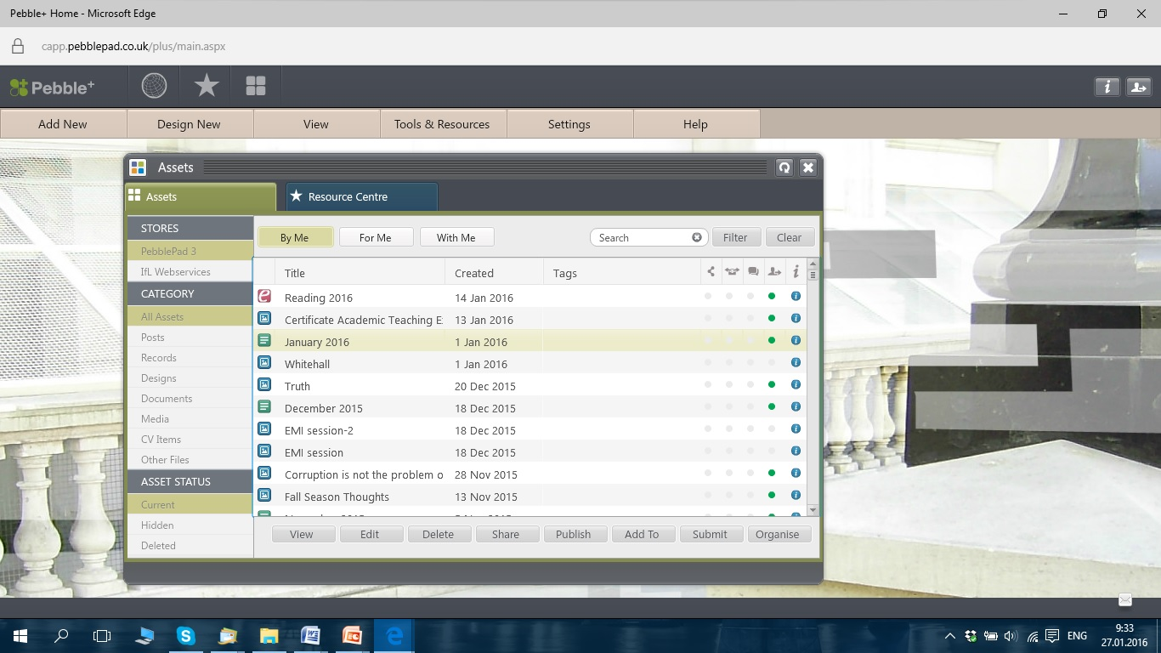
ACADEMIC TEACHING EXCELLENCE | British Council

Slide 4
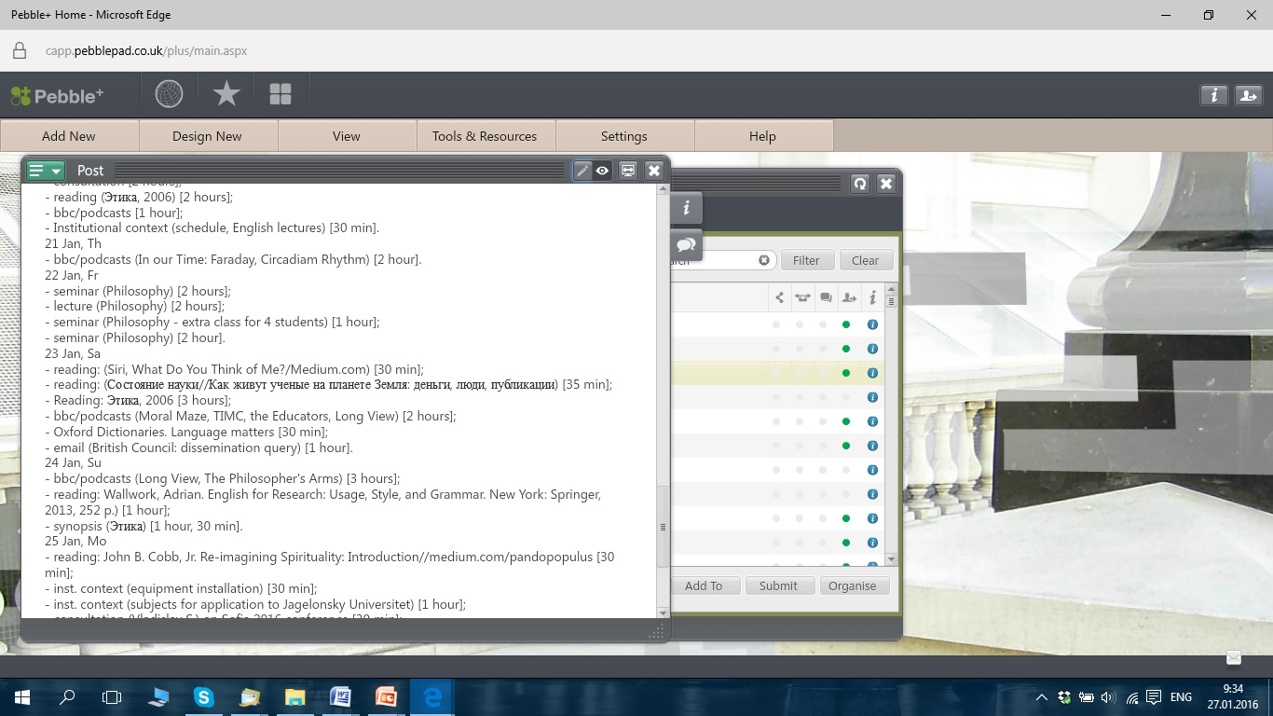
ACADEMIC TEACHING EXCELLENCE | British Council

Slide 5
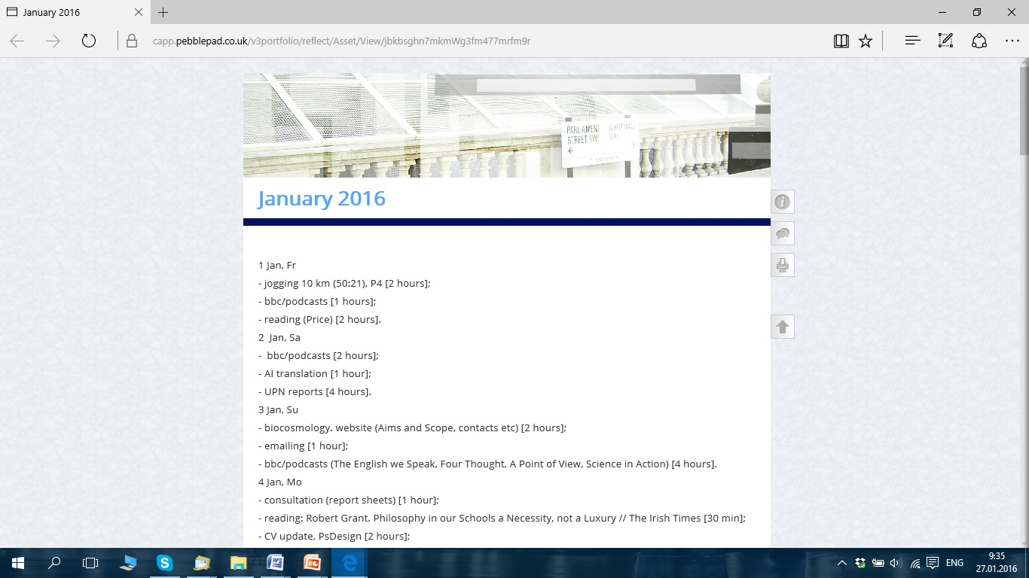
ACADEMIC TEACHING EXCELLENCE | British Council

Slide 6
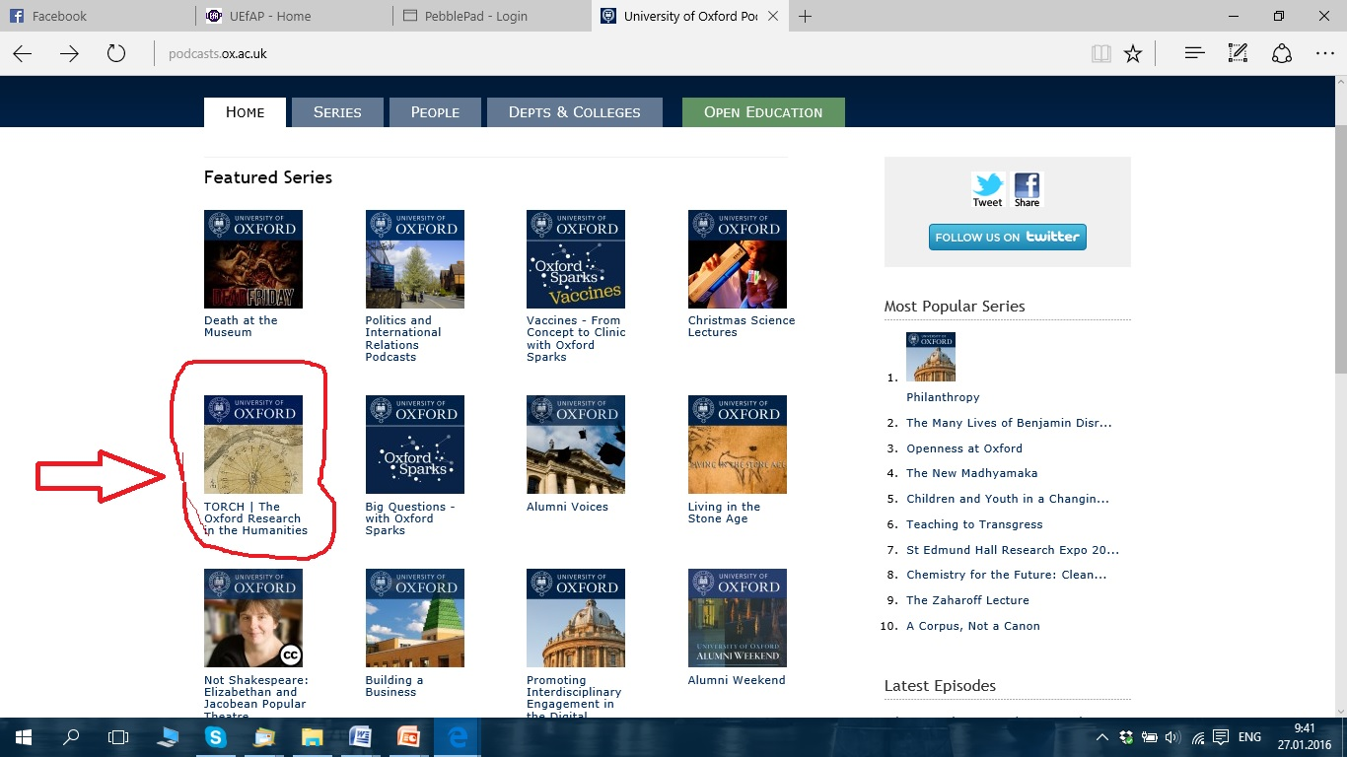
ACADEMIC TEACHING EXCELLENCE | British Council
podcasts.ox.ac.uk

Slide 7
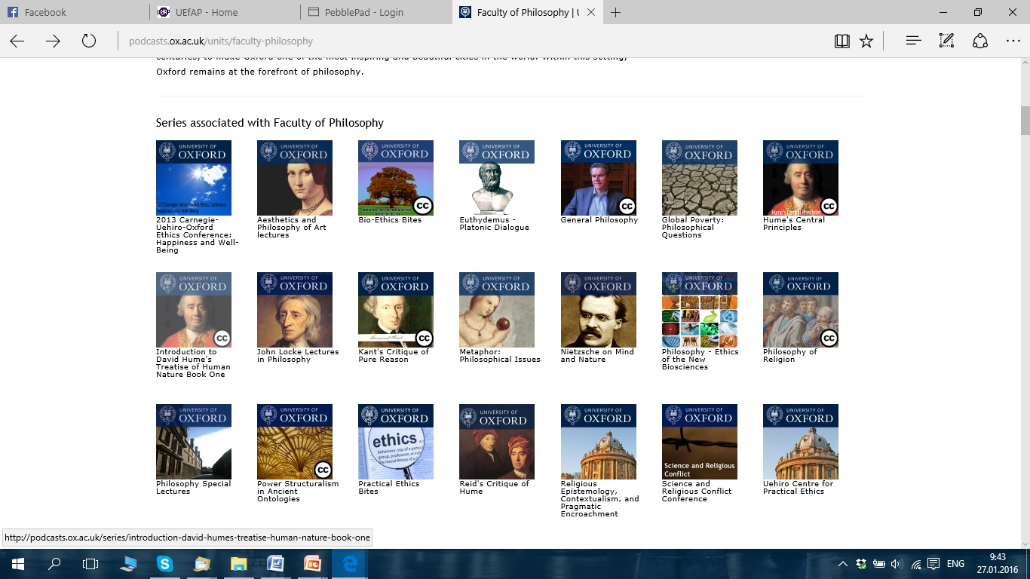

Slide 8
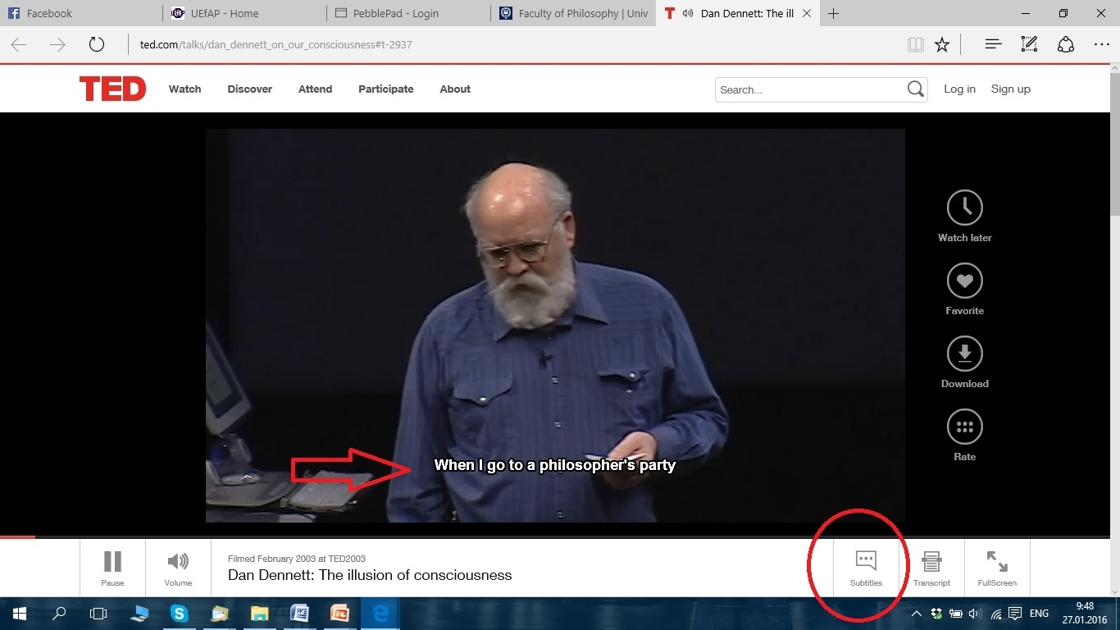

Slide 9
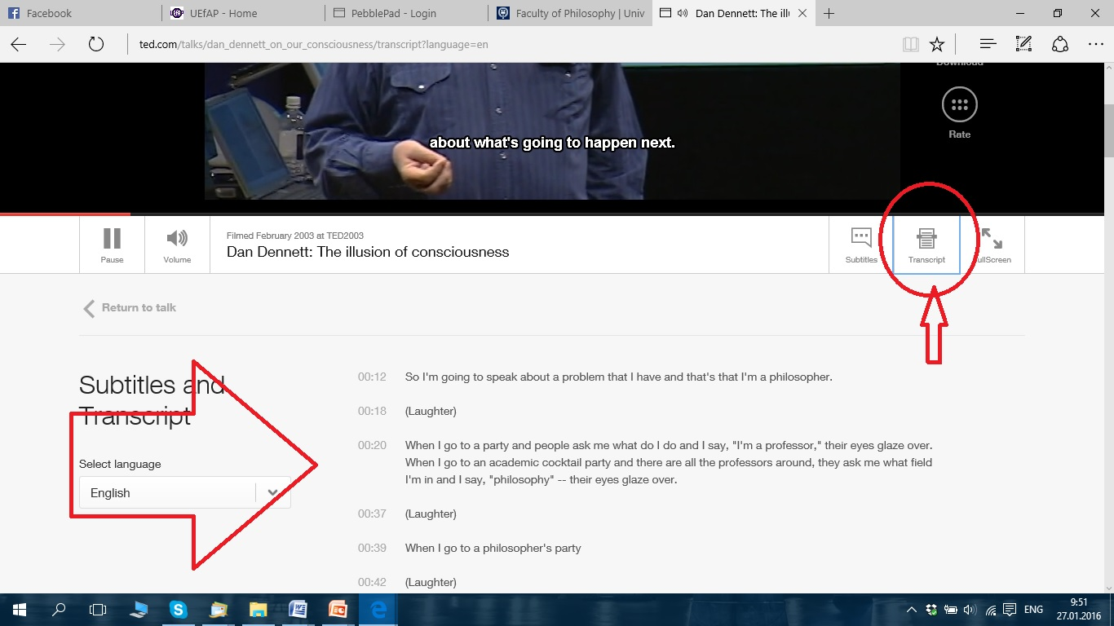

Slide 10
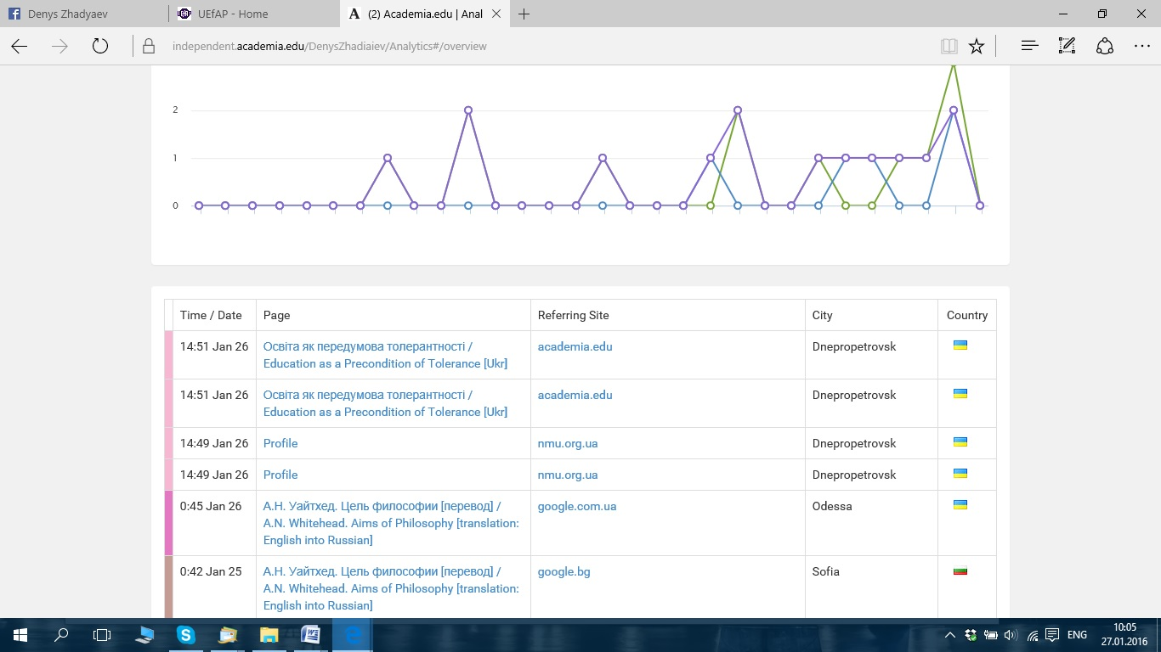
Academia.edu

Slide 11
ACADEMIC TEACHING EXCELLENCE | British Council
For more information please contact me: dzhadyaev@windowslive.com

